Slide 1





Socket Programming Project:
A Multi-user Chat Application
Course: CS440-Computer Network
Dr. Le Quoc Huy
Dr. Truong Huu Tram
1

Slide 2




Hello!
NGUYEN CHANH LONG
PHAN LE KIM TINH
2002043
2102058
LUONG TRIEU VY
2102164
2

Slide 3

Project Overview
1
Project Overview
2
Project Structure
3
Design
4
Demo
5
Challenges and Future Improvements
6
Conclusion
3

Slide 4
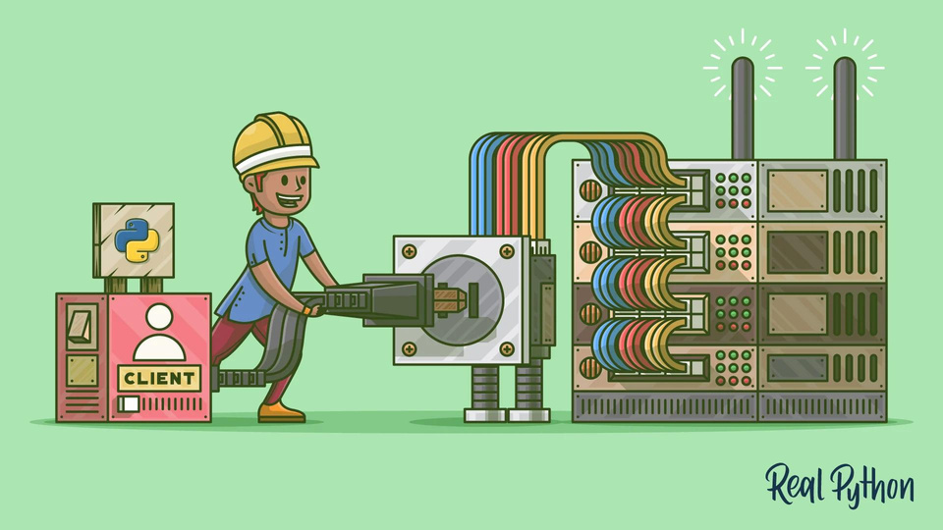
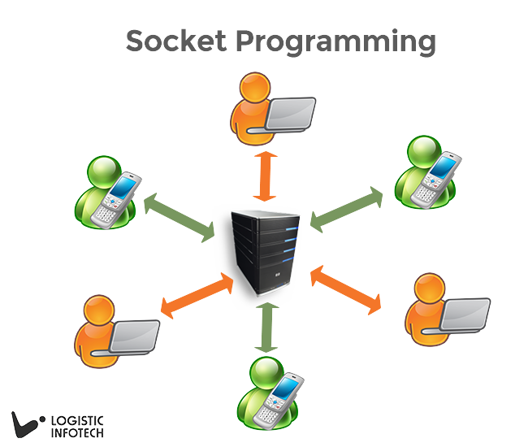

1.Project Overview
Features: User authentication with JWT, private and group chats Technologies used: Python, Flask, MongoDB, Docker
4

Slide 5


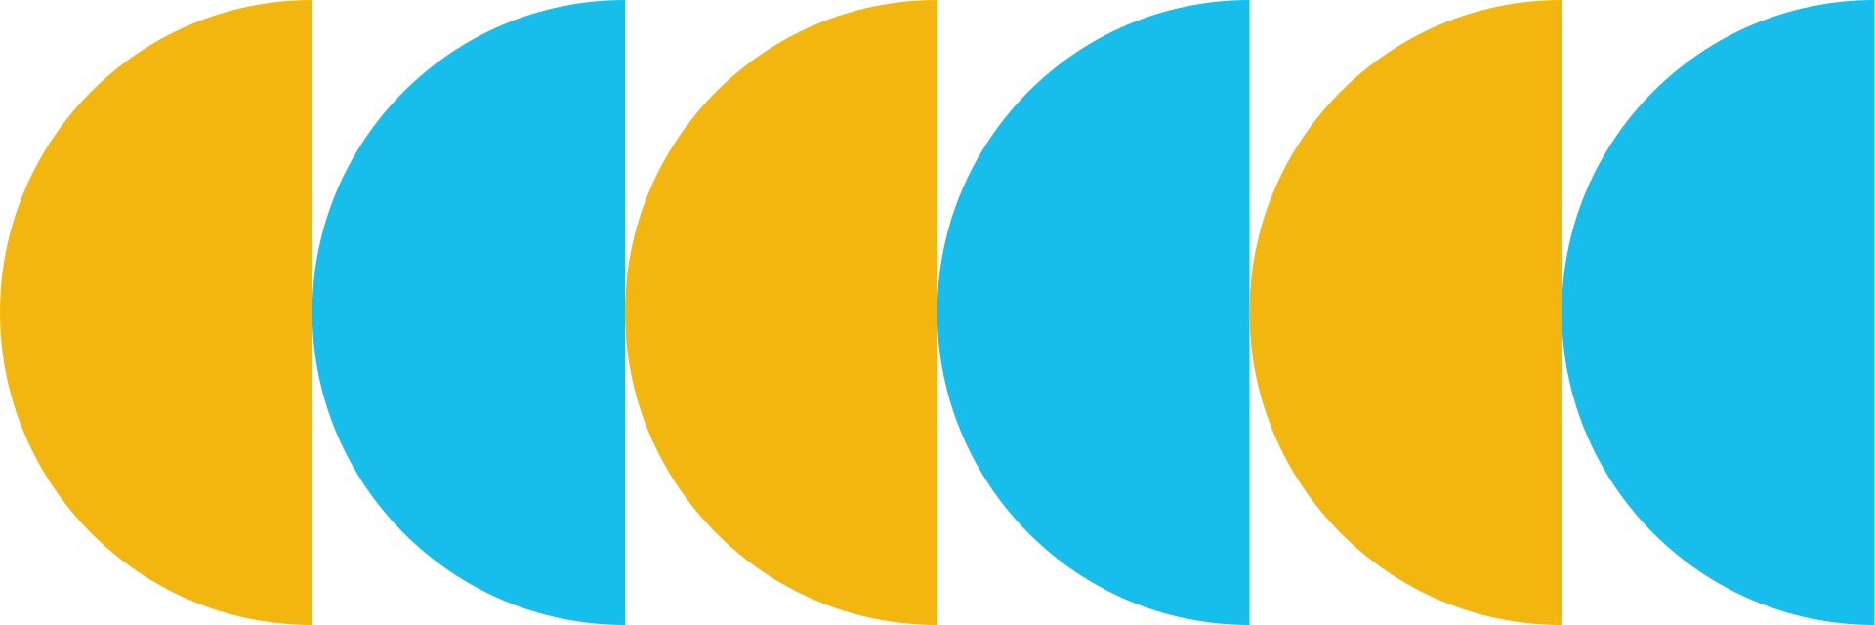

2.Project Structure
Directory Layout:
Directory Layout:
1. api: Core application logic handlers
2. handlers: Manage interactions with the database
3. models: Define data models
4. routes: Define API routes
6. services: Implement socket server and client
7. utils: Utility functions and database connection setup data_socketProject_db
Directory for MongoDB data
8. settings.py: Configuration settings
9. main.py: Entry point for the API and socket server
10. docker-compose.yaml: Docker configuration for MongoDB
5

Slide 6
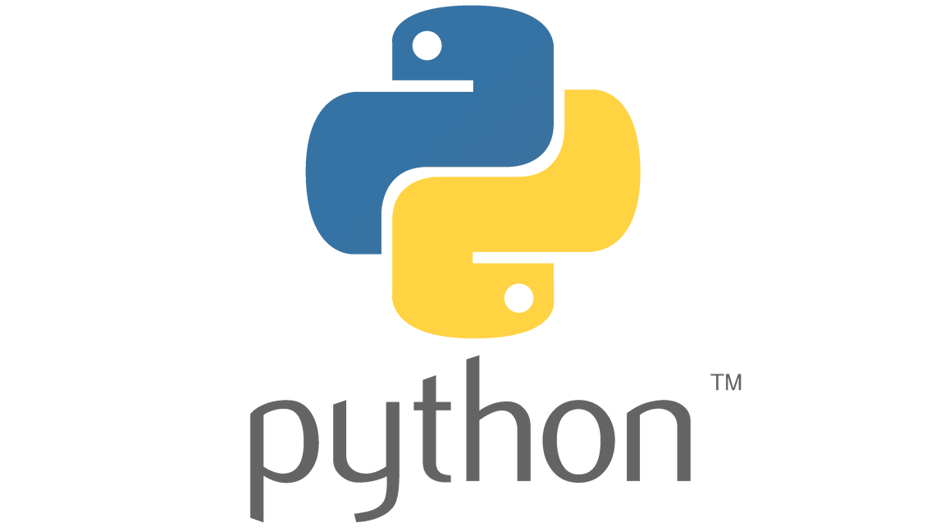

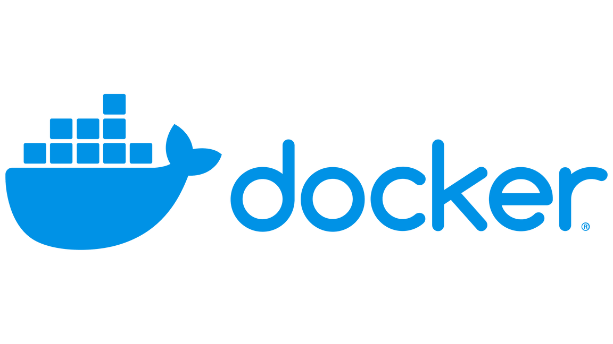
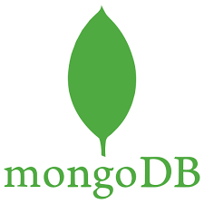
languages, frameworks, libraries, environments.
MongoDB: User Data Storage, Authentication Data Storage, Database Connection.
Flask: API Endpoints, Request Handling, JWT Handling.
Docker: Environment Consistency, Scalability.
Python: Socket Programming, Multithreading, JWT Authentication
6

Slide 7

Key Components
Handlers:
UserHandle: Manages user data
AuthHandle: Manages authentication tokens
Models:
UserProperty: Defines user data structure AuthProperty: Defines authentication token structure Routes:
UsersRoute: User signup and login endpoints
Services:
SocketServer: Manages client connections and message routing
SocketClient: Manages user interaction and server communication
Utils: db_conn.py: Manages MongoDB connections
7

Slide 8
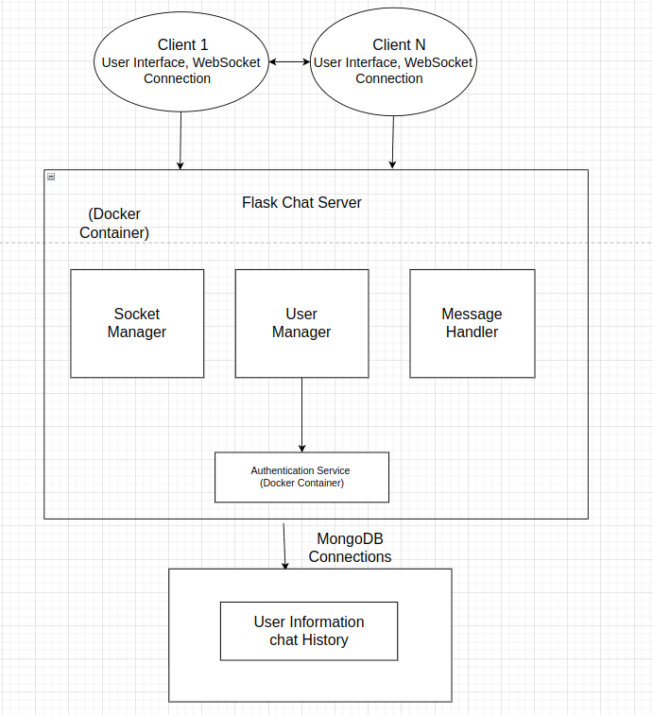
System
architecture
8

Slide 9

Server Design
3. Design
Socket Initialization: initializes a server socket using the TCP/IP protocol and binds it to a specified host and port.
Connection Handling:
“self.server_socket.listen(5)”
“self.server_socket.accept()”
Client Management: Connected clients are managed using two lists: “self.clients” for the client sockets and “self.nicknames” for client nicknames.
Message Broadcasting:
“send_to_other_clients”
“self.clients”
Concurrent Handling:
“threading.Thread(target=self.handle_client, args=(client,))”
9

Slide 10
Client Design
3. Design
Socket Initialization:
initializing a client socket and connecting it to the server's IP address and port
User Input Handling:
The client handles user input by reading messages from the user and sending them to the server
Message Receiving:
“receive_messages”
10

Slide 11


3. Design
Key Features:
User Management:
User signup and login
User information retrieval
Authentication:
JWT-based authentication for secure user login
Chat Functionality:
Supports private and group messaging
Real-time communication using sockets.
11

Slide 12



Sign up account
Command: POST
Domain: http://localhost:5000/signup
Body: JSON
{
"username": "exampletest2@gmail.com",
"password": "secretpassword",
"name_account": "user2"
}
Successful responses: 200
{
"_id": "666da60e0669eafd17284386",
"username": "exampletest2@gmail.com",
"password": "secretpassword",
"name_account": "user2"
}
Error: 400
{ "message": "Missing username, password, or nameaccount" }
{ "message": "User already exists" }
12

Slide 13
Login account
Command: POST
Domain: http://localhost:5000/login
Body: JSON
{
"username": "exampletest2@gmail.com",
"password": "secretpassword"
}
Successful responses: 200
{
"Name Account": "user2",
"User Name": "exampletest2@gmail.com",
"User Password": "secretpassword",
"Access Token": "eyJ0eXAiOiJKV1QiLCJhbGciOiJIUzI1NiJ9..."
}
Error:
400:
{ "message": "Missing username or password" }
401:
{ "message": "User account does not exist!!!" }
13

Slide 14
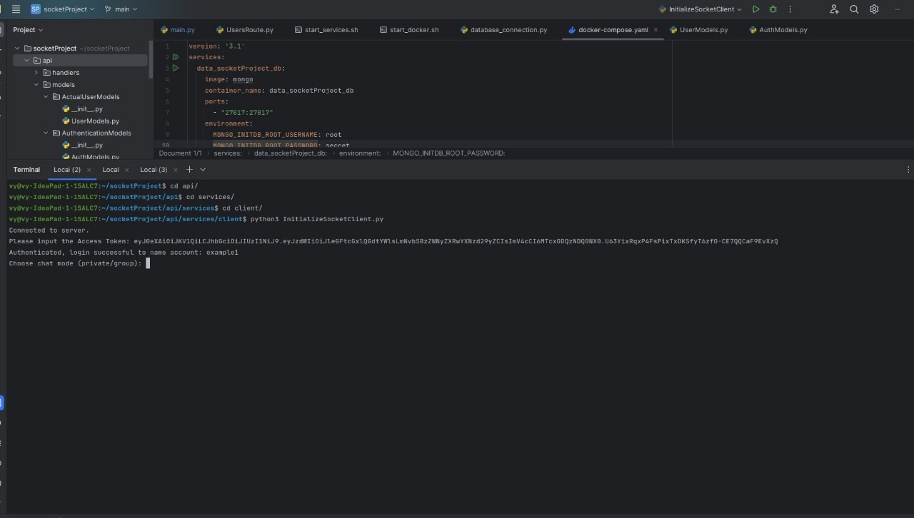
Chat Functionality
14

Slide 15
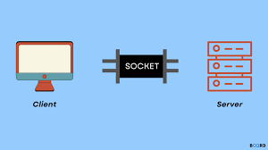

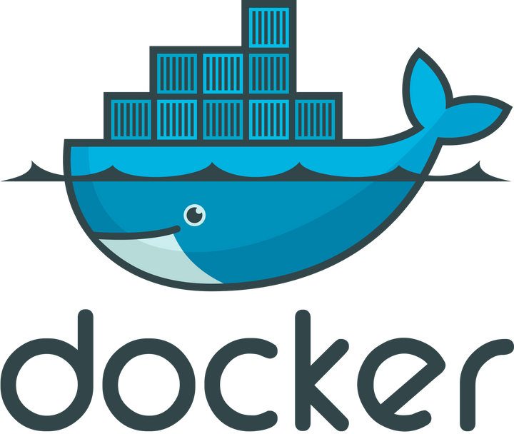

4. Demo
15

Slide 16



5. Challenges and Future Improvements
Graphical User Interface (GUI)
Storage
16

Slide 17






Conclusion
Socket Project chat application effectively combines Python, Flask, and MongoDB to deliver a robust platform for real-time communication. The user management system ensures a seamless signup and login process, while JWT-based authentication guarantees secure user sessions. The chat functionality supports both private and group messaging, offering real-time interaction through socket communication. With Docker-based containerization, the application setup and deployment are streamlined, ensuring consistency across environments. Future enhancements, such as message history, advanced security measures, and an improved user interface, will further elevate the user experience.
17

Slide 18




Any Questions?
18

Slide 19





Thank you
16 June, 2024

